Slide 1
The What’s-It Tree
Notes:
All images cleared for re-use for non-commercial purposes.

Slide 2
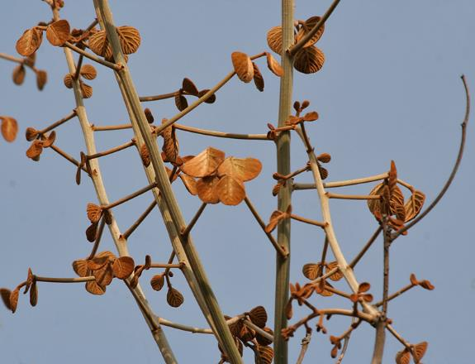
The tree with buds on the trunk…
Notes:
Photograph by J. M. Garg. CC-BY-3.0

Slide 3
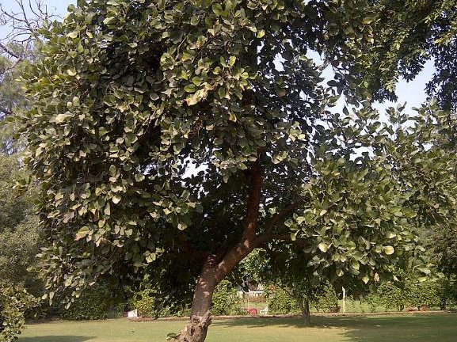
The tree covered in green leaves…
Notes:
Photograph by Aftabbanoori. CC-BY-SA 4.0

Slide 4
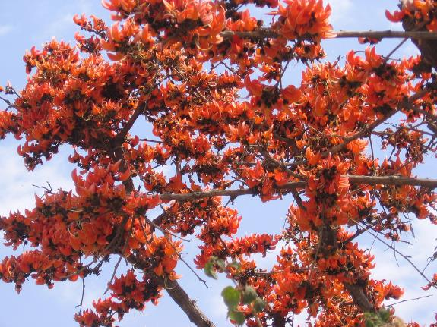
The tree covered in flesh-coloured flowers…
Notes:
Photograph by Lalithamba. CC-BY-2.0

Slide 5
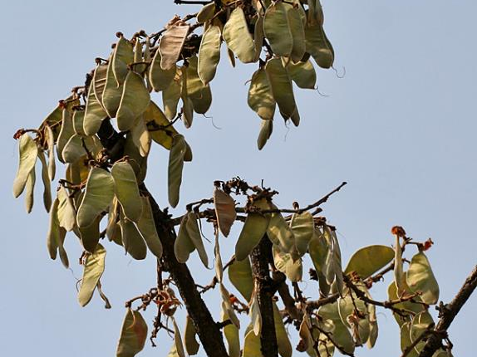
The tree at the time of fruiting…
Notes:
Photograph by J.M. Garg. CC-BY-3.0

Slide 6
Slide 2: Photograph by J. M. Garg. CC-BY-3.0
Slide 3: Photograph by Aftabbanoori. CC-BY-SA 4.0
Slide 4: Photograph by Lalithamba. CC-BY-2.0
Slide 5: Photograph by J.M. Garg. CC-BY-3.0

