Slide 1
The Story of Prince Vessantara
in Thai paintings

Slide 2
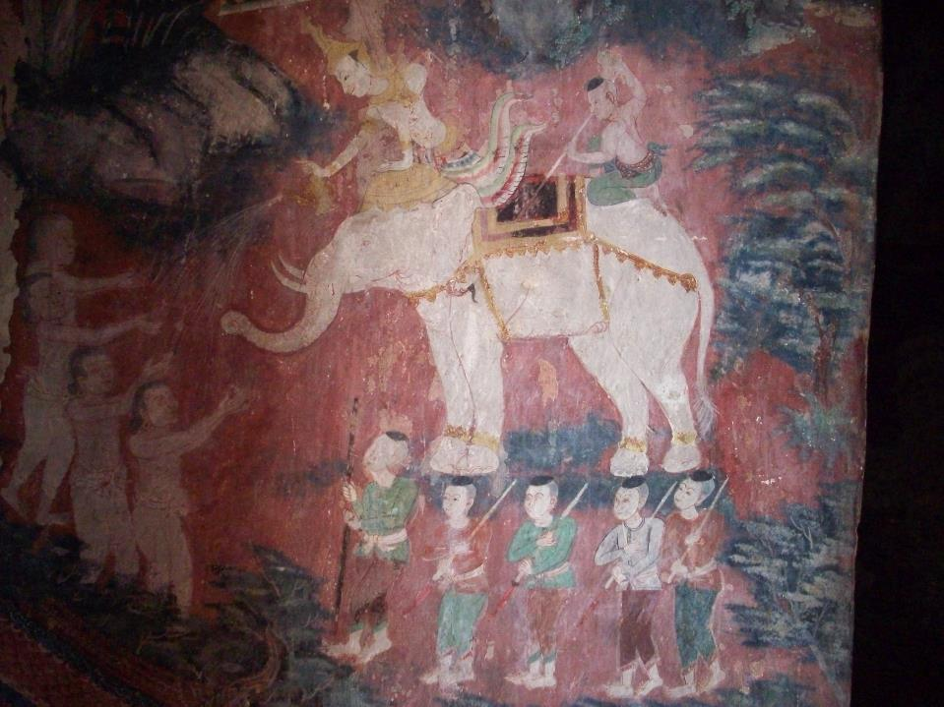
Notes:
Vessantara gives away the elephant. The pouring of water on the hands of the recipients signifies the irreversibility of the gift.
Photograph of painted mural at Wat Makham No / Wat No Phutthangkun, Suphanburi Provice, Thailand, © Naomi Appleton, 2016, CC BY NC (Free to use, share and adapt).

Slide 3
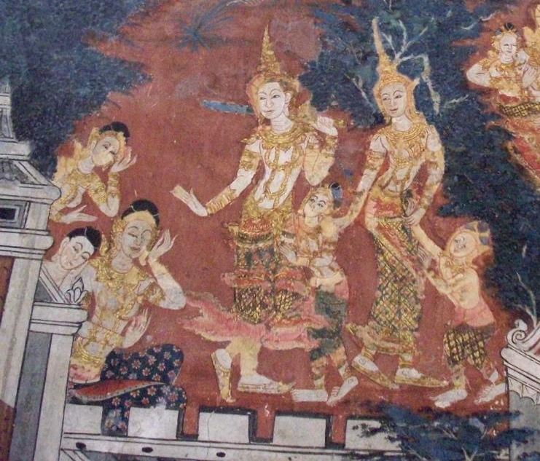
Notes:
Vessantara, Maddi and the children say farewell to the palace.
Photograph of Wat Makham No / Wat No Phutthangkun, Suphanburi Provice, Thailand, © Naomi Appleton, 2016, CC BY NC (Free to use, share and adapt).

Slide 4
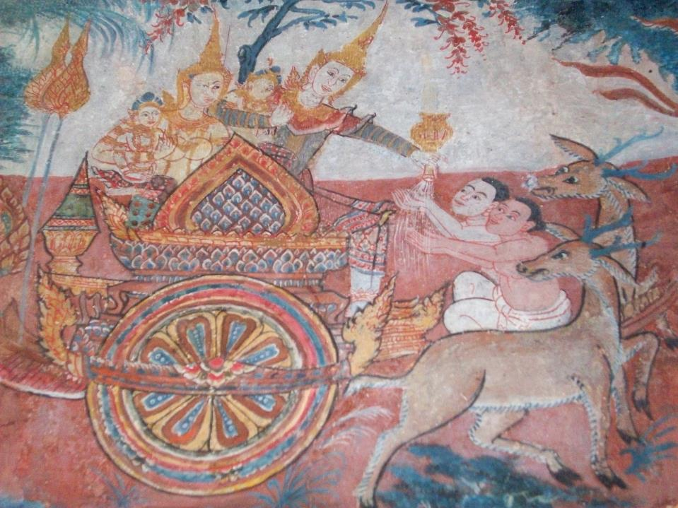
Notes:
Vessantara gives away their carriage. The horses have already been given away, and gods in the form of deer are pulling it.
Photograph of Wat Makham No / Wat No Phutthangkun, Suphanburi Provice, Thailand, © Naomi Appleton, 2016, CC BY NC (Free to use, share and adapt).

Slide 5
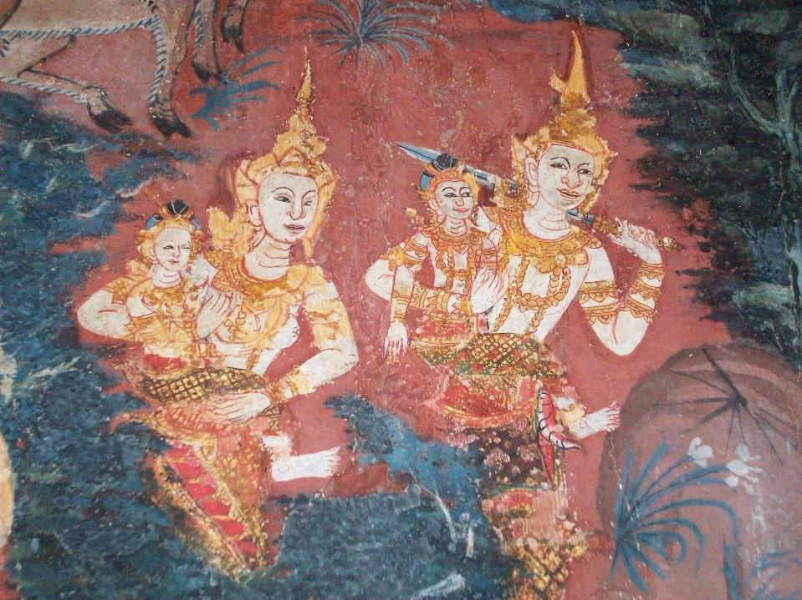
Notes:
Vessantara and his family enter the forest on foot.
Photograph of Wat Makham No / Wat No Phutthangkun, Suphanburi Provice, Thailand, © Naomi Appleton, 2016, CC BY NC (Free to use, share and adapt).

Slide 6
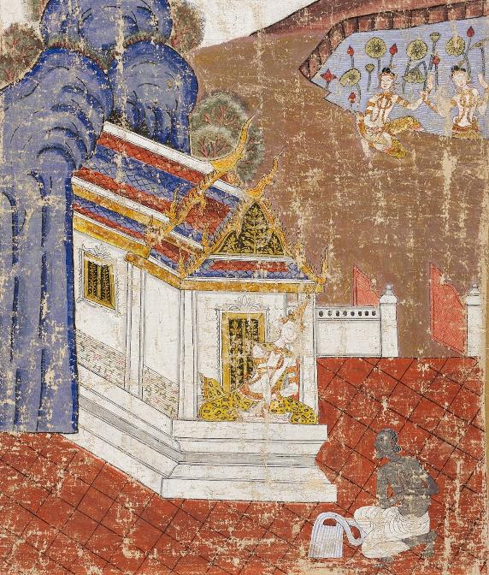
Notes:
Jujuka asks Vessantara for his children as slaves. The children are playing nearby in the lotus pool.
19th century Thai painting, held in the Los Angeles County Museum of Art. Image in the public domain.

Slide 7
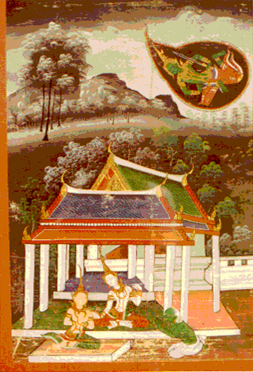
Notes:
Indra (in green) takes disguise as a brahmin and asks for Vessantara’s wife.
19th century Thai painting, held in the Walters Art Museum. Image in the public domain.

Slide 8
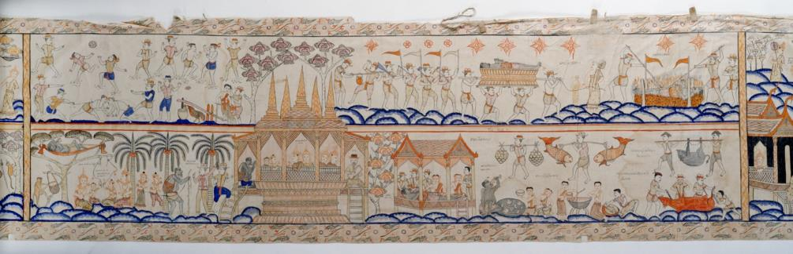
Notes:
This early 20th century painted scroll shows the chapter about Jujuka. On the bottom row we see him bring the children to the city, where they are ransomed by the king. Then Jujuka begins his overeating, leading to his death, shown on the top row.
20th century Thai painted scroll, held in Walters Art Museum. Image in the public domain.

Slide 9
Slide 1: Vessantara gives away the elephant. The pouring of water on the hands of the recipients signifies the irreversibility of the gift.
Photograph of painted mural at Wat Makham No / Wat No Phutthangkun, Suphanburi Provice, Thailand, © Naomi Appleton, 2016, CC BY NC (Free to use, share and adapt).
Slide 2: Vessantara gives away the elephant. The pouring of water on the hands of the recipients signifies the irreversibility of the gift.
Photograph of painted mural at Wat Makham No / Wat No Phutthangkun, Suphanburi Provice, Thailand, © Naomi Appleton, 2016, CC BY NC (Free to use, share and adapt).
Slide 3: Vessantara, Maddi and the children say farewell to the palace.
Photograph of Wat Makham No / Wat No Phutthangkun, Suphanburi Provice, Thailand, © Naomi Appleton, 2016, CC BY NC (Free to use, share and adapt).
Slide 4: Vessantara gives away their carriage. The horses have already been given away, and gods in the form of deer are pulling it.
Photograph of Wat Makham No / Wat No Phutthangkun, Suphanburi Provice, Thailand, © Naomi Appleton, 2016, CC BY NC (Free to use, share and adapt).
Slide 5: Vessantara and his family enter the forest on foot.
Photograph of Wat Makham No / Wat No Phutthangkun, Suphanburi Provice, Thailand, © Naomi Appleton, 2016, CC BY NC (Free to use, share and adapt).
Slide 6: Jujuka asks Vessantara for his children as slaves. The children are playing nearby in the lotus pool.
19th century Thai painting, held in the Los Angeles County Museum of Art. Image in the public domain.
Slide 7: Indra (in green) takes disguise as a brahmin and asks for Vessantara’s wife.
19th century Thai painting, held in the Walters Art Museum. Image in the public domain.
Slide 8: This early 20th century painted scroll shows the chapter about Jujuka. On the bottom row we see him bring the children to the city, where they are ransomed by the king. Then Jujuka begins his overeating, leading to his death, shown on the top row.
20th century Thai painted scroll, held in Walters Art Museum. Image in the public domain.

