Slide 1
The Descent of the Ganges
Some helpful (hopefully) images…

Slide 2
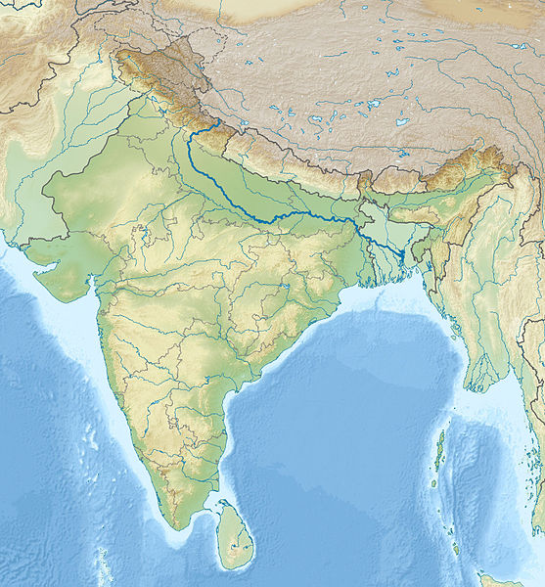
Map of India with the River Ganges highlighted
Notes:
By 배우는사람 CC-BY-SA 3.0

Slide 3
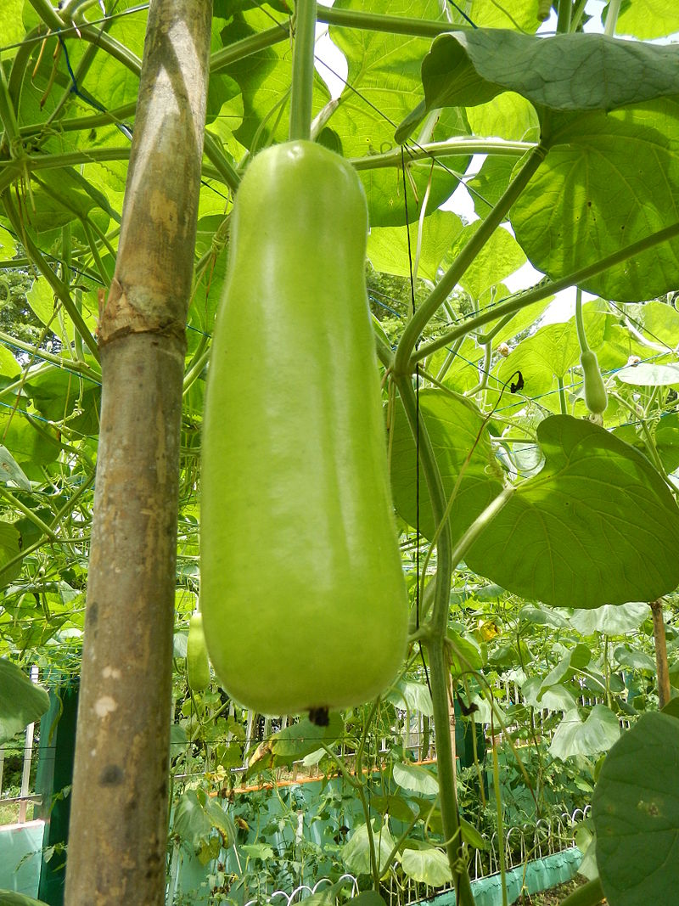
A gourd, related to a squash or courgette.
Notes:
Photo by Judgefloro, CC-BY-SA 4.0.

Slide 4
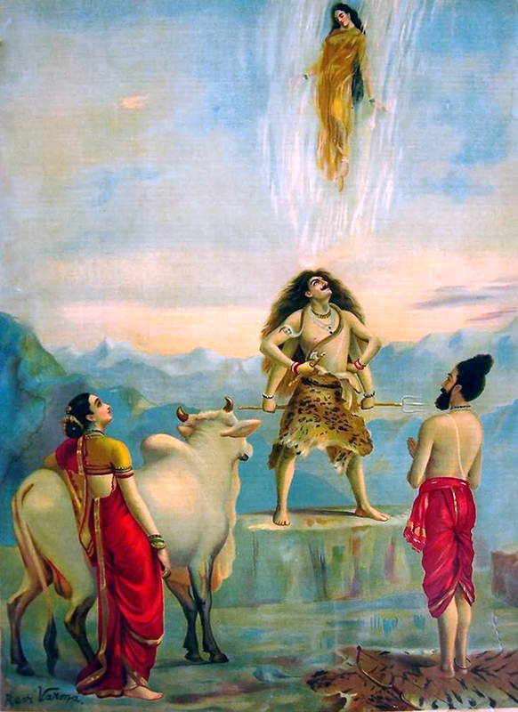
The descent of the Ganges into Shiva’s hair
Notes:
watched by Shiva’s wife Parvati, the bull Nandi, and Bhagiratha. Painting by Raja Ravi Varma, c. 1910. Image in the public domain

Slide 5
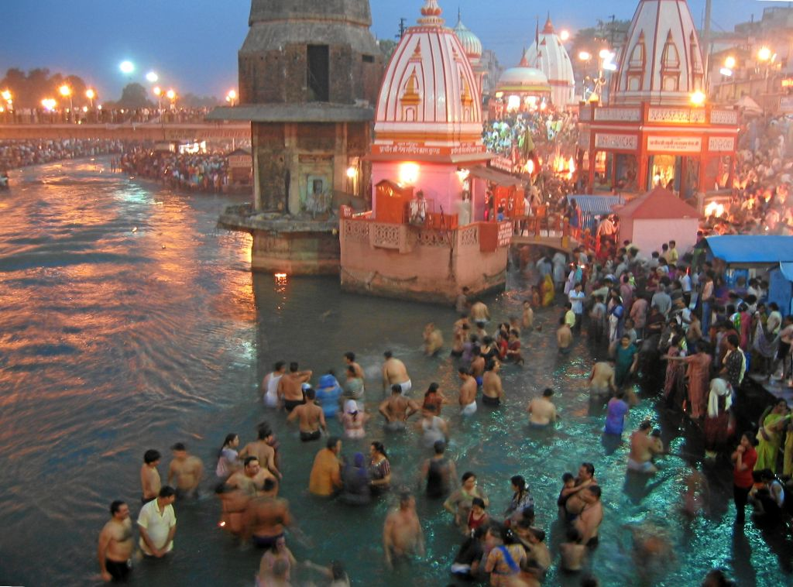
The 2010 Kumbh Mela (bathing festival) at Haridwar, on the Ganges river.
Notes:
Photograph by Dick Hartung, CC-BY-SA 2.0

Slide 6
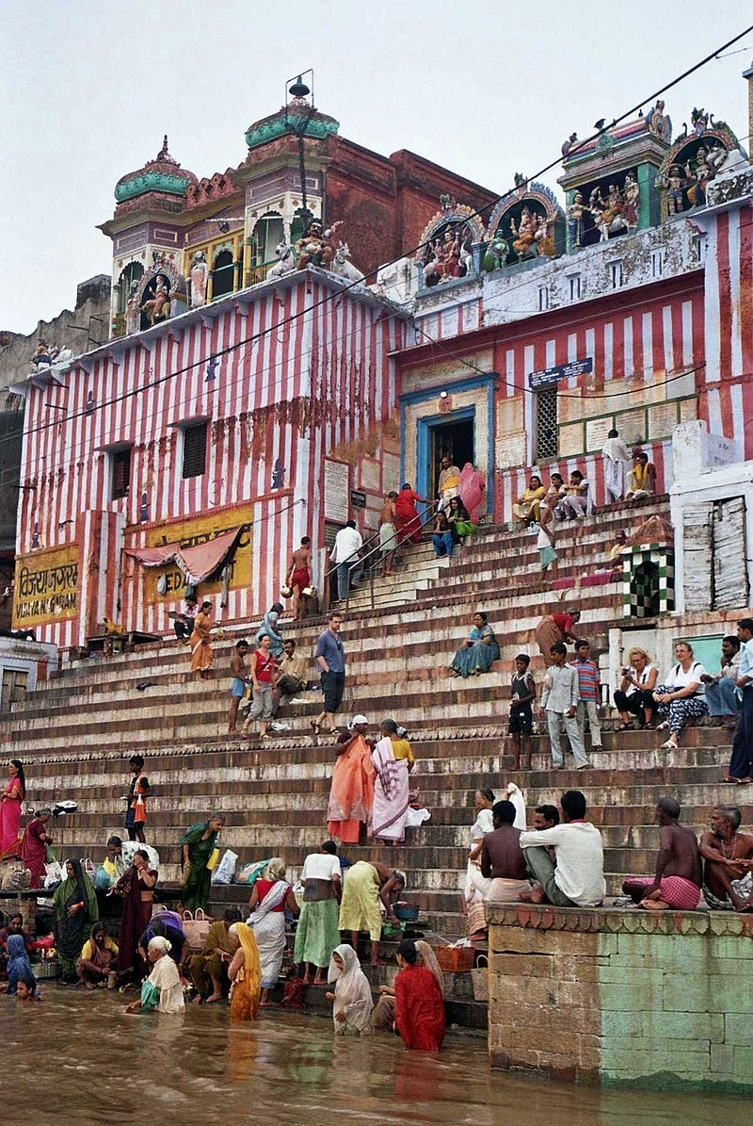
A ghat at Varanasi
Notes:
Photo by Andreasegde, CC-BY-SA 2.0.

